Slide 1
Introduction to Databases
Dr. Shaheen Khatoon
Shaheen.Khatoon@xjtlu.edu.cn

Slide 2
Chapter 7
Data Modeling Using the Entity-Relationship (ER) Model

Slide 3
Chapter 7 Outline
Using High-Level Conceptual Data Models for Database Design
Entity Types, Attributes, and Keys
Relationship Types

Slide 4
Data Modeling
Before designing database, based on model of real world objects, you need to choose a suitable design methodology to:
  Accurate representation of objects in the real world
  Flexible enough to accommodate future processing requirements
  Help to design database sequentially, eliminate trial and error, use the design plan and drawings to document the database, and modify database more easily

Slide 5
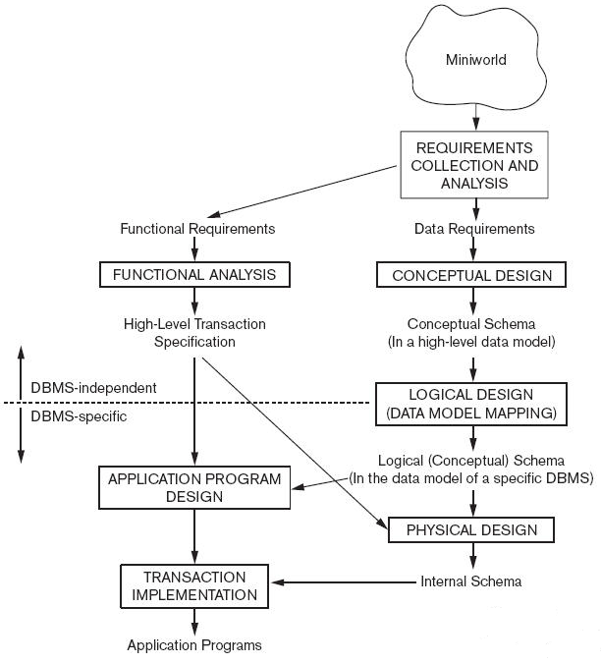

Overview of DB Design Process

Slide 6
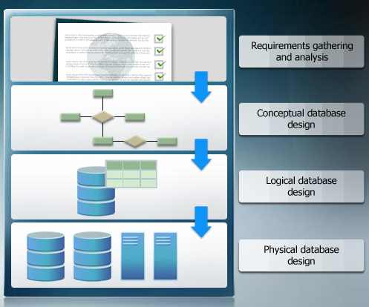
Database Design Life Cycle

Slide 7
Using High-Level Conceptual Data Models for Database Design
Requirements collection and analysis
  Database designers interview prospective database users to understand and document data requirements
  Result: data requirements
  Functional requirements of the application

Slide 8
Using High-Level Conceptual Data Models (cont’d.)
Conceptual schema
  Conceptual design
  Description of data requirements
  Includes detailed descriptions of the entity types, relationships, and constraints
  Transformed from high-level data model into implementation data model

Slide 9
Using High-Level Conceptual Data Models (cont’d.)
Logical design or data model mapping
  Result is a database schema in implementation data model of DBMS
Physical design phase
  Internal storage structures, file organizations, indexes, access paths, and physical design parameters for the database files specified

Slide 10
Entity-Relationship (ER) Model
Popular high-level conceptual data model
list all entities and attributes as well as all relationships between the entities that are of importance.
Provides background information such as entity descriptions, data types, and constraints.
ER diagrams
  Diagrammatic notation associated with the ER model

Slide 11
Data Modeling Tools
A number of popular tools that cover conceptual modeling and mapping into relational schema design:
  Examples: ErWin, S-Designer (Enterprise Application Suit), ER-Studio, ER Assistant, drawio, etc.
  SQL developer data modeler for data modeling and mapping in relational schema task:http://www.oracle.com/technetwork/developer-tools/datamodeler/overview/index.html
Advantages: Serve as a documentation of application requirements, easy user interface, mostly graphics editor support.

Slide 12
ERM
Includes all entities and relationships among them −Is called an entity-relationship model (ERM)
Is illustrated in an ERD
  Specifies all attributes and UIDs for each entity
  Determines attribute optionality
  Determines relationship optionality and cardinality

Slide 13
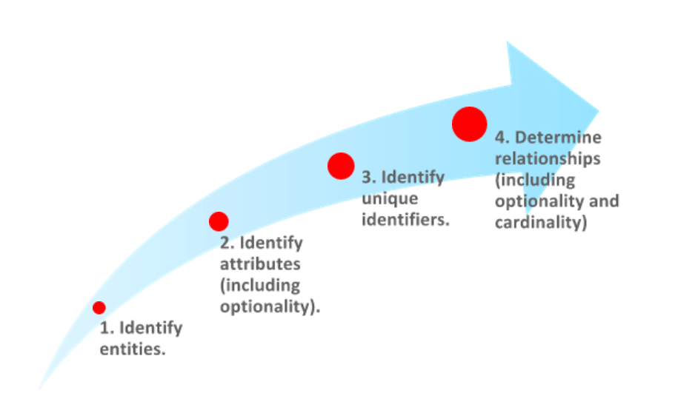
Steps to Create ER Model
Slide 1-<number>

Slide 14
Entities, Instance and Attributes
Entity
  “Something” of significance to the business about which data must be known
  Thing in real-world with independent existence
  A name for a set of similar things that you can list
  Usually a noun
Entities can be:
  Tangible, like PERSON or PRODUCT
  Intangible, like SKILL LEVEL
  An event, like CONCERT

Slide 15
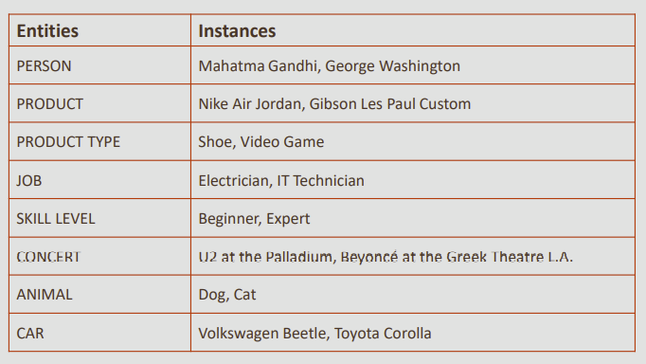
Entities, Instance and Attributes
Instance
  Entities have instances
  An instance is a single occurrence of an entity

Slide 16
Entities, Instance and Attributes
Is DOG an instance or an entity?
−It depends:
  If we consider many different kinds of animals, it makes sense to think of the entity ANIMAL to include instances DOG, CAT, HORSE and so on
  But what if we run a dog-breeding business? We will need to keep data on many different breeds of dogs, but not on other species of animal
  For a dog-breeder, it is more natural to think of an entity DOG to include instances TERRIER, POODLE, LABRADOR and so on

Slide 17
Entities, Instance and Attributes
Attributes
  Like an entity, an attribute represents something of significance to the business
  An attribute is a specific piece of information that helps: −
    Describe an entity
    Quantify an entity
    Qualify an entity
    Classify an entity
    Specify an entity
  An attribute has a single value

Slide 18
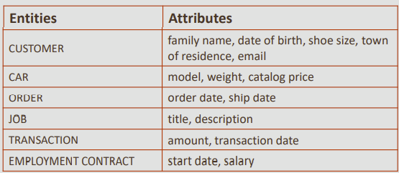
Entities, Instance and Attributes
Attributes
  Attributes have values.
  An attribute value can be a number, a character string, a date, an image, a sound, etc
  These are called "data types" or "formats"

Slide 19
Attributes
Attribute Is Single-Valued
an instance of an entity can have only one value for each attribute at any point in time.
  This is the most important characteristic of an attribute.
The attribute value, however, may change over time
  For example: The entity CAR may have attributes “model” and “color.” There can be only one value for these (for example, “Beetle” and “green”) at one time, for each instance (i.e. for each individual car). Although the model remains the same over the lifetime of the car, its color can change.

Slide 20
Attributes
volatile attributes
  Some attributes (such as age) have values that constantly change
  volatile attributes will need to be updated frequently.
nonvolatile attributes
  Other attributes (such as order date) will never change
If given a choice, select the nonvolatile attribute
  For example, age must be updated every year. How long would this take if we had 1 million customers?
  If we need to know a customer’s age, we can easily deduce it from the birth date.

Slide 21
Attributes
Mandatory attributes
  Some attributes must contain a value—these are mandatory attributes
  For example: in most businesses that track personal information, name is required
Optional attributes
  Other attributes may either contain a value or be left null—these are optional attributes (Not required)
  For example: cell phone number is often optional except in mobile or wireless applications
Null: A value that is unavailable, unassigned, unknown, or empty; it is neither a zero nor a space
Example: Email address could be a mandatory attribute for EMPLOYEE in an email application, but an optional attribute for CUSTOMER in an online catalog

Slide 22
Types of Attributes
Simple attribute (sometimes called atomic):
  Each entity has a single value for the attribute. For example, the SSN or Sex of an employee.
Composite attribute (also called compound):
  The attribute may be composed of several components. For example:
    Address(Apt#, House#, Street, City, State, ZipCode, Country), or
    Name(FirstName, MiddleName, LastName).
    Composition may form a hierarchy where some components are themselves composite).
Multi-valued attribute (also called repeating group or collection):
  An single entity may have multiple values for that attribute. For example, Color of a CAR or PreviousDegrees of a STUDENT.
    Denoted as {Color} or {PreviousDegrees}.

Slide 23
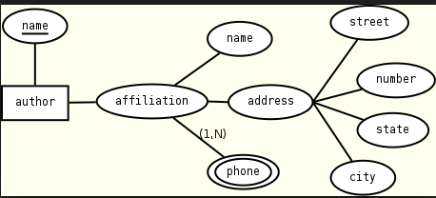

Slide 24
Attributes
Identifier
  An EMPLOYEE has a unique identifier (UID)
  A UID is either a single attribute or a combination of multiple attributes that distinguishes one employee from another
  How do you find a specific employee that works for the company?
  What information uniquely identifies one EMPLOYEE?
  Example:
    Think about all the students in the classroom
    Each student is described by several traits or attributes
    Which attribute or attributes allow you to pick a single student from the rest of the class?
    That is the student’s UID

Slide 25
Entity-Relationship Diagram (ERD)
An entity relationship diagram (ERD) is a consistent tool that can be used to represent the data requirements of a business regardless of the type of database that is used, and even in the absence of one!
A drawing that is used to represent a data model.
There are four goals of ER modeling:
  Capture all required data
  Ensure that data appears only once
  Model no data that is derivable from other data already modeled
  Locate data in a predictable, logical place

Slide 26
Relationship in Data Model
Relationship
  Represent something of significance or importance to the business
  Show how entities are related to each other
  Exist only between entities (or one entity and itself)
  Are bi-directional and named at both ends
  Have optionality and cardinality

Slide 27
Relationship Optionality
  Relationships are either mandatory or optional
  Consider the two entities EMPLOYEE and JOB
  Based on what you know about instances of the entities, you can determine optionality by answering two questions: −
  Must every employee have a job?
    In other words, is this a mandatory or optional relationship for an employee?
  Must every job be assigned to an employee?
    In other words, is this a mandatory or optional relationship for a job?

Slide 28
Relationship Optionality
Relationships between Two Entities
Each object/instance of entity E₁ is related to at most 1 instance of E₂
EMPLOYEE (E1)
mandatory
Optional
JOB(E2)

Slide 29
Relationship Cardinality
Cardinality measures the quantity of something
In a relationship, it determines the degree to which one entity is related to another by answering the question, “How many?”
For example:
  How many jobs can one employee hold? One job only? Or more than one job?
  How many employees can hold one specific job? One employee only? Or more than one employee?
  Note: The cardinality of a relationship only answers whether the number is singular or plural; it does not answer with a specific plural number

Slide 30
Relationship Cardinality
Relationships between Two Entities
Each object/instance of entity E₁ is related to at most 1 instance of E2 and each instance of E2 related to 0 _{or} many _{instance of E1}
EMPLOYEE (E1)
JOB(E2)

Slide 31
Optionality and Cardinality
Optionality: Must or may?
Cardinality: How many?
Examples:
  Each EMPLOYEE must hold one and only one JOB
  Each JOB may be held by one or more EMPLOYEEs
  Each PRODUCT must be classified by one and only one PRODUCT TYPE
  Each PRODUCT TYPE may classify one or more PRODUCTs

Slide 32
Types of Relationships
One to- Many (1:M)
Many-to-Many (N:M)
One-to-One (1:1)
C1
One-to-one
C2
C1
One-to-Many
C2
C1
One-to-Many
C2

Slide 33
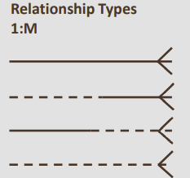
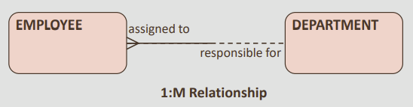
One-to-Many (1:M) Relationships
The various types of 1:M relationships are most common in an ER Model
  “Many” can mean one-or-more or zero-or-more, depending on the optionality. Can be mandatory at both ends

Slide 34
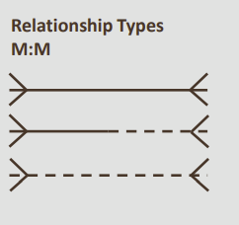
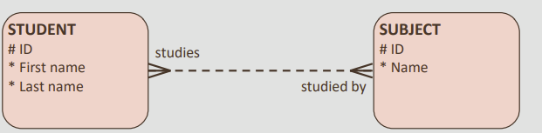
Many-to-Many (M:M) Relationships
The various types of M:M relationships are common, particularly in a first version of an ER model
M:M relationship often modelled with an intersecting entity

Slide 35
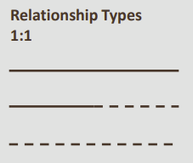
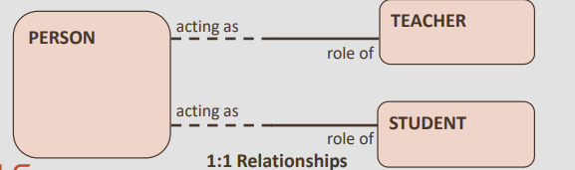
One-to-One Relationships
Usually you will find just a few of the various types of 1:1 relationships in every ER model
Mandatory at one end of the 1:1 relationship commonly occurs when roles are modeled

Slide 36
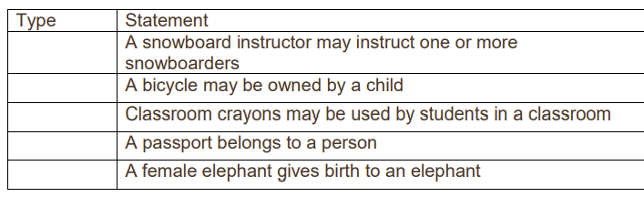
Try It / Solve It
identify the relationship types of the statements below

Slide 37
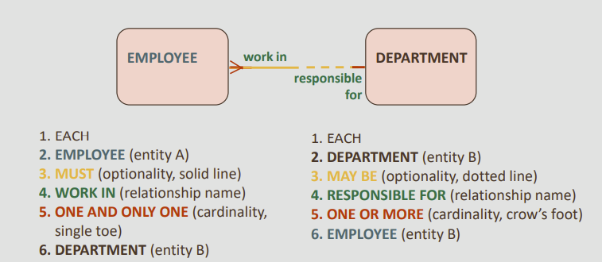
Relationship
we read the relationship from left to right and right to left (or top to bottom, depending on the ERD layout)
Each EMPLOYEE must work in one and only one DEPARTMENT.
EACH DEPARTMENT may be responsible for one of more EMPLOYEEs.

Slide 38
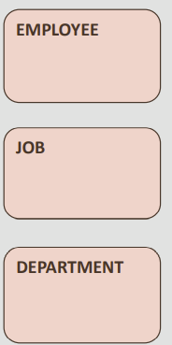
ER Conventions
Entities are represented by softboxes
Entity names go in the softboxes
Entity names are always singular and written with all capital letters

Slide 39
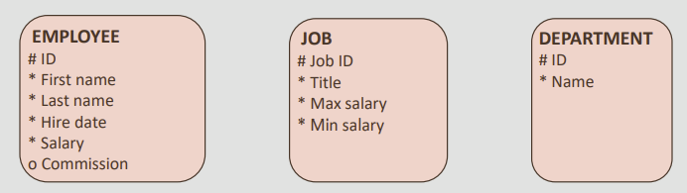
ER Conventions
Attributes are listed under the entity names
  Mandatory attributes are marked with an asterisk: “*”
  Optional attributes are marked with a circle: “o”
  Unique identifiers are marked with a hash sign: “#”

Slide 40
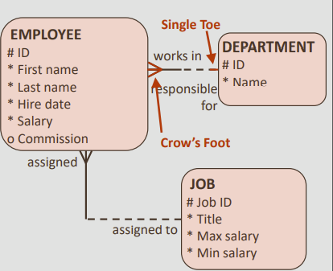
ER Conventions
Relationships are lines that connect entities
These lines are either solid or dashed
These lines terminate in either a “single toe” or a “crow’s foot” at the end of each entity

Slide 41
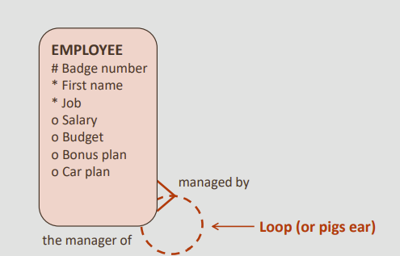
ER Conventions
The ERD convention to show a recursive relationship is drawn as a loop, also known as a “pig’s ear”

Slide 42
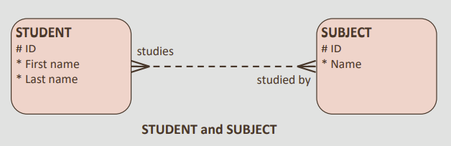
Resolving many to M:M relationship with attribute
Consider the below example
In a school, a STUDENT may study one or more SUBJECTs
Each SUBJECT may be studied by one or more STUDENTs

Slide 43
Attributes of Relationship Types
Attributes of 1:1 or 1:N relationship types can be migrated to one entity type
For a 1:N relationship type
  Relationship attribute can be migrated only to entity type on N-side of relationship
For M:N relationship types
  Some attributes may be determined by combination of participating entities
  Must be specified as relationship attributes

Slide 44
Resolving many to M:M relationship with attribute
When a student enrolls for a subject, we want to be able to record the grade they attain for that subject
  Which entity would the attribute “Grade” belong to?
  If we put “Grade” in the STUDENT entity, how would we know which SUBJECT it is for?
  If we put “Grade” in the SUBJECT entity, how would we know which STUDENT got that grade?
  The grade is an attribute of the many-to-many relationship between STUDENT and CLASS, not of either entity alone.

Slide 45
Resolving many to M:M relationship with attribute
Consider the below example
A third entity is needed to resolve the M:M relationship
This is called an "intersection" entity

Slide 46
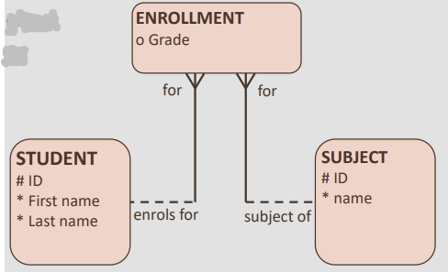
Intersection Entity
An intersection entity – ENROLLMENT – has been added, including the “Grade” attribute
The original M:M relationship has become two 1:M relationships
What would be the UID of the intersection entity?
Intersection entity: The product of the resolution of a many to many relationship
Note that the relationships have become mandatory at the side of the Intersection entity, as an ENROLLMENT cannot exist without a corresponding STUDENT and SUBJECT

Slide 47
Barred Relationships
The unique identifier (UID) of the intersection entity often comes from the originating relationships and is represented by the bars
In this case, the relationships from the originating entities to the intersection entity are called "barred" relationships
Barred Relationships

Slide 48
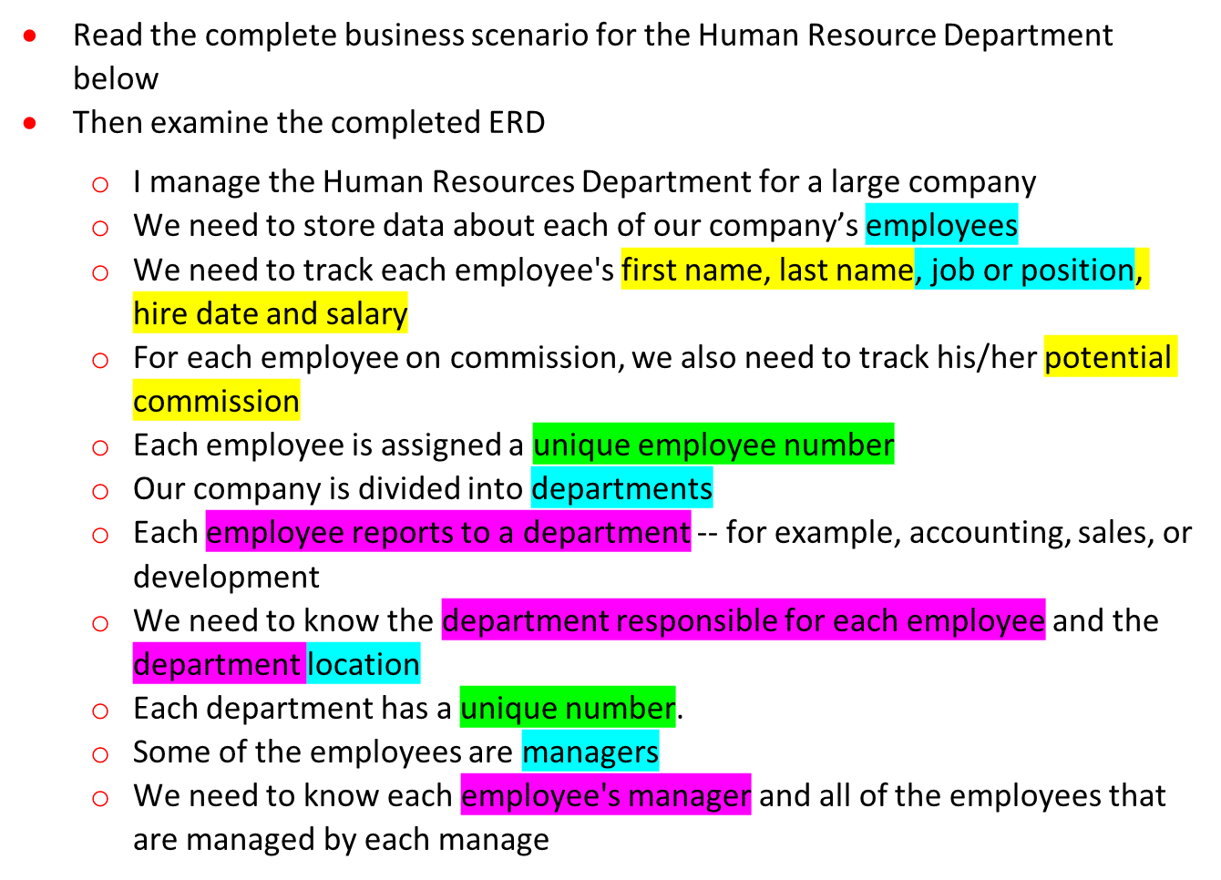
H.R. Department Business Scenario

Slide 49
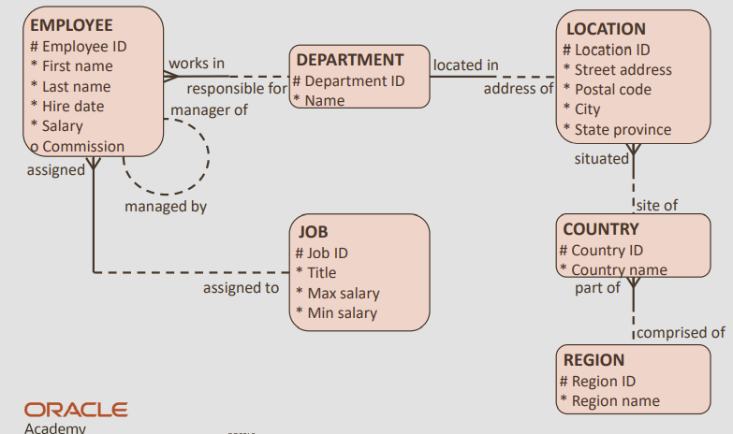
H.R. Department ERD

Slide 50
A Sample Database Application
COMPANY
  Employees, departments, and projects
  Company is organized into departments
  Department controls a number of projects
  Employee: store each employee’s name, Social Security number, address, salary, sex (gender), and birth date
  Keep track of the dependents of each employee

Slide 51
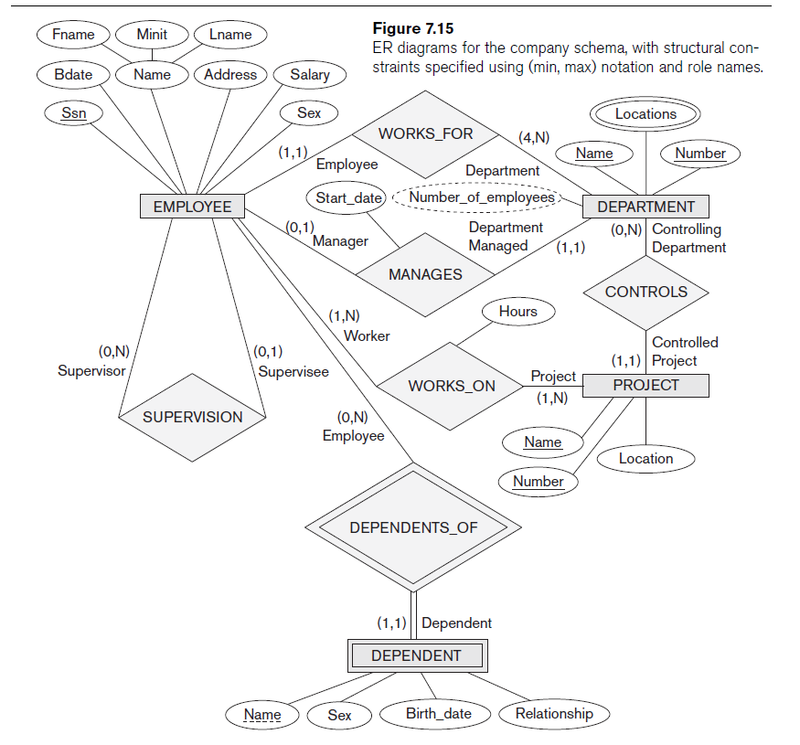

Slide 52
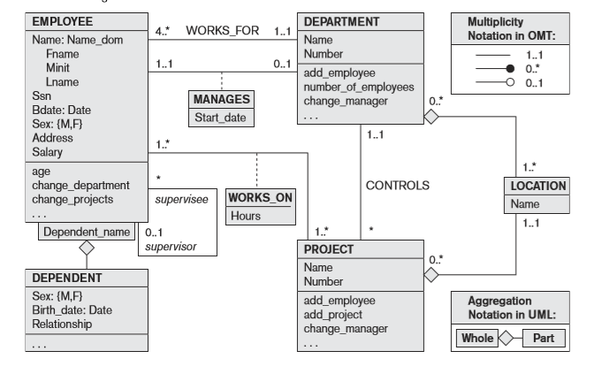
The COMPANY conceptual schema in UML class diagram notation

Slide 53
ER Practice
Consider a MAIL_ORDER database in which employees take orders for parts from customers. The data requirements are summarized as follows:
The mail order company has employees, each identified by a unique employee number, first and last name and zip code. Each customer of the company is identified by a unique customer number, first and last name, and zip code. Each part sold by the company is identified by a unique part number, a part name, price, and quantity in stock. Each order placed by a customer is taken by an employee and is given a unique order number. Each order contains specified quantities of one or more parts. Each order has a date of receipt as well as an expected ship date. The actual ship date is also recorded.
Design an ER diagram for this application.

Slide 54
MOVIE Database: Home Work
Consider a MOVIE database in which data is recorded about the movie industry. The data requirements are summarized as follows:
  Each movie is identified by title and year of release. Each movie has a lenghth in minutes. Each has a production company and each is classified under one or more genres (such as horror, action, drama etc). Each movie has one or more directors and one or more actors appearing in it. Each movie also has a plot outline. Finally each movie has zero or more quotable qoutes, each of which is spoken by a particular actor appearing in the movie. Actors are identified by name and date of birth and appear in one or more movies. Each actor has a role in the movie. Directors are also identified by name and dateof birth and direct one or more movies. It is possible for a director to act in a movie (including one that he or she may also direct). Production companies are identified by name and each has an address. A production company produces one or more movies.
Design an ER diagram for this application.

Slide 55
Virtual Library system: Home Work
In a “Virtual Library” system a database is to be created to enable users to browse books, search stored books, and to read books online.
A user can browse books using categories; each book is classified into exactly one category. Moreover, a user can browse books using authors; any book has at least one author. A book is composed of any number of pages; in which, each one holds some text.
Search function should allow a user to filter the list of books using the book title, year of publish, author, and/or category. Moreover, a user can search the library looking for some text, the system should return in this case all books with each book page number(s) that contain the given text.

Slide 56
Summary
Basic ER model concepts of entities and their attributes
  Different types of attributes
  Different Types of Relationship
ERD Notations

